Slide 1
ACCOMMODATIONS & CONCESSIONS
TRAINING (GRADE R-12)
2019
Notes:
ASSESSMENTS

Slide 2
WHAT ARE ACCOMMODATIONS/CONCESSIONS?
Accommodations refer to the use of differentiated methods of assessment to support learners who experience barriers to assessment
Concessions refer to permission granted to learners to be exempted from certain subjects or sections of the curriculum content
Differentiation in assessment and accommodations are designed to equalise opportunities for all learners by addressing barriers which learners may experience
Support for learners to enable them to give a true account of their knowledge and/or skills
The standard of assessment must not be compromised, nor should the learner be given an unfair advantage over his or her peers;
It is important that differentiated assessment and/or accommodations are put into practice early and throughout learners’ school career to give them the opportunity to realise their potential

Slide 3
LEGISLATIVE FRAMEWORK
Government Gazette, No. 37651, 16 May 2014
National Protocol for Assessment Grades R-12, Chapter 9 (discusses the three types of Assessment)
Education White Paper 6-Special Needs Education: Building an Inclusive Education and Training System
National Policy Pertaining to the Conduct, Administration and Management of the National senior Certificate Examination, Annexure C1
National Education Policy Act, 1996
(Act No. 27 of 1996)
Screening Identification, Assessment and Support Policy Document

Slide 4
ELIGIBILITY
Learners who are eligible for accommodations or concessions are:
Those who have special educational needs arising from a disability, learning difficulty, behaviour and/or psycho-social disorder which creates a barrier to the learner achieving his/her potential in the assessment; or
Those who during the assessment or examination period, experience medical, social, emotional or psycho-social challenges

Slide 5
ELIGIBILITY Cont…
Accommodations or concessions are not granted where the primary area of difficulty is with the language of learning, teaching and assessment due to the fact that this is not the home language of the learner
Learners who are eligible for differentiated assessment and accommodations should be identified as early as the Foundation Phase, after all remedial measures have been exhausted
Accommodation needs may change over time, requiring a re-evaluation after each phase or as the need arises

Slide 6
STRUCTURES IN ACCOMMODATIONS/CONCESSIONS PROCESSES
School Based Accommodations Committee (SBAC)
District Based Accommodations Committee (DBAC)
Provincial Based Accommodations Committee (PBAC)
Directorate: Assessment and Examinations

Slide 7
SCHOOL BASED ACCOMMODATIONS COMMITTEE
Identify learners eligible for accommodations with regard to examinations and assessments in terms of the level and nature of support required
Liaise with parents
Obtain relevant reports
The initial assessment will be conducted by the SBAC by using the SIAS policy
Where there are specialist support services at the school they are required to submit relevant, current and comprehensive information on the learner, applicable to their areas of expertise, which will support the request for the accommodation
Prepare and submit all applications to DBAC, requesting relevant accommodations/concessions
Mediate the final decision in writing on applications to relevant stakeholders and implement appropriately

Slide 8
DISTRICT BASED ACCOMMODATIONS COMMITTEE
Mediate the relevant policies and provincial guideline documents to SBAC
Develop a DBAC management and training plan
Submit to PBAC for quality assurance and approval
Further assessments, if required, will be facilitated by the DBAC
Consider applications for examination and assessment accommodations received from SBAC, verify documentation of learners and recommend the appropriate accommodations in terms of DBE form 124
Process accommodations applications from Grade 1-9 (approval of readers and scribes to be done at PBAC)
Submit a summary of all applications with recommendations to the PBAC upon request and avail the relevant documentation and reports

Slide 9
DBAC cont…
Identify, train and certify readers and scribes (certificate valid for two years)
The DBAC must ensure that officials (LSE’s as well) are trained as invigilators, readers and scribes to assist in emergencies during assessment and exams
Mediate final decisions on applications in writing to the SBAC
Prepare required outcome letters for Grade 1-11 and distribute to SBAC
Submit appeals to PBAC

Slide 10
PROVINCIAL BASED ACCOMMODATION COMMITTEE
Mediate the policy documents for accommodations to DBAC
Inform DBAC of time frames and management plans in line with the National Senior Certificate and provincial requirements
Consider DBAC recommendations for accommodations/concessions with subsequent approval, non-approval or approval with amendments
Create a database of all accommodation/ concession applications
Forward all required details of examination accommodations/concessions for Grade 12 to the Director: Assessment and Examinations

Slide 11
DIRECTORATE:ASSESSMENT AND EXAMINATIONS
Facilitate the generation of Grade 12 response letters only for accommodations
All other letters are generated by the DBAC

Slide 12
APPEALS
An accommodations/concessions decision may be appealed within 2 months of receipt of the original decision
The outcome of an appeal cannot be re appealed
Only the original application will be considered
The department reserves the right to request further assessment

Slide 13
Types of Accommodations/Concessions

Slide 14
ADDITIONAL TIME
Impairment | Additional time that may be made available
Physical Disability/Repetitive Strain Injury | 5 to 10 minutes per hour to accommodate slower writing speed
Learning Disability | Maximum 20 minutes per hour for perusal/formulating/writing/checking answers
Chronic Pain | 15 minutes per hour for standing/walking around
Vision Impairment | Double time for learners who are blind and time and a half for learners who have low vision or partially sighted
Hearing Loss | 20 minutes per hour for perusal/ formulating/writing/checking answers
Any other disability not identified in the above list | May use the above mentioned time allocation not exceeding 20 minutes per hour

Slide 15
USE OF A SCRIBE
A learner may be granted the use of a scribe by the PBAC if :
The writing speed is significantly slow (evidence is required)
Handwriting is illegible (samples of learner work is required)
Learners are unable to write due to an injury/physical disability (a report is needed from a medical practitioner/ relevant therapist detailing how the condition affects the ability to write)
Where use of a computer is not an option (for the above three circumstances)
Learners with significant visual impairment not yet proficient with Braille or any other devices for the visually impaired
Learners who make use of the scribe also qualify for additional time and separate venue

Slide 16
USE OF A READER
A learner may be granted a use of a reader by PBAC if:
There is an impairment with reading which is confirmed through appropriate assessments
There is a diagnosed visual impairment and the learner is not yet proficient with Braille or any other devices for the visually impaired
Learners who make use of a reader also qualify for additional time and separate venue

Slide 17
SEPARATE VENUE
The use of a separate venue is to assist an individual learner for medical, emotional or academic reasons
A medical report is required detailing the condition, how it affects the learner and the support required e.g. if a separate venue is required for an anxiety disorder- a psychological/psychiatrist report is needed
If a separate venue is required for e.g. for learners using computers and there are more than one, then three to four can be seated in one venue

Slide 18
USE OF A PERSONAL ASSISTANT
A personal assistant may be required by learners with physical disabilities/injuries to provide assistance with manual tasks at the learner’s request. E.g. If a learner has a physical disability, the personal assistant might assist to turn pages for them or take a jacket off
A report is required by a medical practitioner or relevant therapist confirming the condition and detailing how it impacts the ability to function
The personal assistant may only speak to the candidate to clarify the request
The personal assistant may be familiar with the learner, but not teach the subject
The personal assistant should not discuss any matters with the learner unless it relates to the learner’s need for personal care or assistance
A separate venue is required

Slide 19
HANDWRITING
A handwriting sticker is provided for learners whose handwriting is very difficult to read but not illegible (and for whom the use of a computer is not possible)
Copies of learner’s work is required as proof
A handwriting sticker is affixed to the cover of the answer book

Slide 20
SPELLING
Spelling accommodation is granted when the spelling mistakes made by the learner compromises the learner’s ability to express written language
Evidence of the learner’s work in the LOLT is required
A spelling sticker is placed on the answer books of the learner. The marker must not penalize spelling mistakes as long as what is written is phonetically correct
Note that in the Language Papers where spelling is part of the content knowledge required at Grade 12 level, correct spelling is needed
A spelling sticker is not granted when the difficulty is with the LOLT which is different to the home language of the learner

Slide 21
MEDICATION/ FOOD INTAKE
It is granted to learners with medical conditions such as Diabetes to take medication or food when needed
A medical report is required detailing the condition, how it affects the learner and the support required
Rest breaks should also be applied for in conjunction with this accommodation
A separate venue will also be required

Slide 22
REST BREAKS
A rest break is granted to a learner who is not able to remain seated for the duration of the examination due to an injury or medical condition
A medical report is required detailing the condition, how it affects the learner and the support required
Rest break time does not count as extra writing time
A separate venue is required

Slide 23
USE OF A COMPUTER
A computer is requested when:
A learner has writing that is illegible
learners with physical disability/injury affecting hand dexterity (a medical report or report by the relevant therapist is required detailing the condition, how it affects handwriting and the support required)
In case of power cuts, a scribe must be used
A separate venue is required
The learner must have experience in using a computer
All applications, programs and networks on the computer that may assist the learner, must be disabled

Slide 24
USE OF A PROMPTER
It is granted for learners who are easily distracted, affecting the assessment and exams process
A detailed report is required which outlines the severity and history
A separate venue is required
The invigilator cannot be the prompter
The prompter will observe if the learner is distracted and will refocus the learner with either a verbal cue or a physical cue (tap on the shoulder or desk)
The prompter cannot have any communication with the learner beyond the verbal and physical cue to re-focus

Slide 25
BRAILLE & LARGE PRINT
Learners diagnosed with visual impairments have different support needs depending on the severity e.g. font size, Braille or assistive devices
An ophthalmologist/optometrist report must detail the condition, how it impacts on the learner and the support required e.g. font size
Learners with diagnosed visual impairment receive additional time as stipulated
Type of Braille required (contracted and uncontracted) and font size, must be indicated on the DBE 124 form

Slide 26
DIGITAL RECORDER, VIDEO RECORDER, WEB-CAM
A recording of the entire examination proceedings must be made whenever a separate venue is utilised. This recording must be submitted with the examination script
The recording device must be tested prior to its use in each examination and the battery life checked. Should the battery power be low, new batteries must be inserted to the device prior to the examination
Digital recordings need to be copied to a CD at the end of each examination and submitted with the candidate’s answer booklet
This requires the use of a separate venue. The examination proceedings must be recorded by the invigilator on a digital recording device

Slide 27
SIGN LANGUAGE INTERPRETER
This accommodation is provided in schools where the LOLT is SASL
An audiological evaluation must be included
The individual interpreting cannot also be the invigilator
The interpreter must be competent in SASL
The interpreter interprets while the chief invigilator reads the instructions and the questions
The interpreter does not interpret the questions when there is an adapted question paper, only the instruction

Slide 28
ADAPTED QUESTIONS
This accommodation is granted to:
Blind or visually impaired learners
Deaf or hard of hearing learners
Learners with physical barriers

Slide 29
EMERGENCY ACCOMMODATIONS
It refers to support required in cases of e.g. pregnancy, trauma, abuse, hospitalization, imprisonment and injury occurring prior or during the exam/assessment
A medical report is required detailing the condition, how it affects the learner and the support required
Support could include any of the previous mentioned accommodations or what might be most appropriate depending on the nature of the emergency
The process for an emergency accommodation is that if the documentation cannot reach the PBAC due to the immediate nature of the emergency, the DBAC to contact PBAC telephonically to obtain approval. If PBAC cannot be contacted, DBAC to make a decision and inform PBAC within 24 hours and evidence to be forwarded within three days

Slide 30
CONCESSIONS
N/B The following concessions deviate from policy as it affects the PROMOTION CRITERIA:
EXEMPTION FROM A SECOND LANGUAGE
This concession is granted to Immigrant learners
An Immigrant learner may be granted a concession to exempt them from offering a second language (Gr 10 -12). Gr 7 - 9 second language is not used as promotional requirement.
In this case, the second language must be replaced by another subject
A copy of the Asylum-seeking papers/study permit is needed
For an immigrant learner to obtain this concession, the learner must have arrived in South Africa in Grade 7 or later

Slide 31
CONCESSIONS Cont…
B. EXEMPTION FROM MATHEMATICS OR MATHEMATICAL
LITERACY
Learners Gr 1 – 9 has Mathematics – Not used as promotional requirement.
Learners with dyscalculia are granted a concession exempting them from offering Mathematics/Mathematical Literacy (Grades 10 -12), by the Assessment Directorate
A psychological report, previous school reports and samples work of the learner are required

Slide 32
DEVIATION FROM POLICY
There is a Deviation from Policy when the promotion criteria are not met
A FORMAL SUBMISSION IS REQUIRED
THE SUBMISSION MUST BE FORWARDED TO THE ASSESSMENT & CURRICULUM DIRECTORATE

Slide 33
EVIDENCE REQUIRED
Screening tool
Developed by PBAC used to grant:
additional time
Visual Impairment / Blindness
Opthalmologist report/medical report/optician report/optometrist
Deaf/ Hard of Hearing
Medical report, (ENT), Audiologist report
Physical Barriers
Medical report/relevant therapist report
Behaviour, Anxiety, ADD/ADHD, Autism, Psycho-social Disorders
Medical report
Psycho-educational assessment report
Psychiatric Report
Specific learning disabilities
Psycho-educational report

Slide 34
EVIDENCE REQUIRED CONT….
Other Conditions must include:
Medical report/ report by relevant professionals
In addition to the above, each application must include:
DBE 124
SIAS Forms (SNA 1- 3)
Supporting Historical evidence
School report
Samples of written work (where necessary)
Professionals will make recommendations but the final decisions will be done at the level of the PBAC

Slide 35
TRAINING OF READERS AND SCRIBES
Definitions:
SCRIBE: The practice where a candidate reads the questions and the writes down the candidate’s response verbatim
READER: The practice where a person reads the questions to a candidate and the candidate writes down the response
READER & SCRIBE: The practice where a person reads the questions to a candidate and writes down the candidate’s response verbatim

Slide 36
RESPONSIBILITY OF THE READER/SCRIBE
The Scribe/Reader should preferably be trained teachers or appropriate professional persons. They should not be related to the candidate, and should not be the candidate’s relevant subject teacher
It remains an exam situation. The learner should be made as comfortable and relaxed as possible, but the atmosphere should be professional and formal

Slide 37
RESPONSIBILITY OF THE READER/SCRIBE Cont..
The professionalism and integrity of the reader/scribe must be maintained at all times
The candidate may not be disadvantaged under any circumstances. This includes any form of explanation that might convey the answer to a question, facial expressions or gestures, verbal expressions, clues or remarks, emphasis of words that could benefit the learner
The reader/scribe must remain neutral at all times

Slide 38
PROCEDURES PRECEDING THE USE OF A READER/SCRIBE
The learner will be informed by the class teacher that he/she will get support in terms of a reader and/or a scribe
The trained educator will prepare the learner on what to expect during the session
Before the test or examination, the reader/scribe must introduce him/herself to the learner and inform the learner about the venue of the test/examination
Assistance from a reader/scribe may not take place in the examination room. A separate, suitable room should be provided for each learner

Slide 39
PROCEDURES PRECEDING THE USE OF A READER/SCRIBE Cont..
Two question papers for each learner must be provided by the subject teacher: one for the learner and one for the reader/scribe. Scribbling paper must also be supplied by the examiner
At the end of each session, the reader/scribe will personally return the examination paper to the subject teacher
No marks will be deducted because the candidate made use of a reader/scribe
When writing an external examination, a recording of the examination must be made and be submitted together with the answer book

Slide 40
PROCEDURES WHEN MAKING USE OF A READER/SCRIBE Cont.
Instructions to be read to the candidate before exam or test:
I will read the question to you and write down your answer
You may request a question or part of a question to be repeated
Take note of the allocation of marks at the end of each question
You may answer or plan any of the questions in rough and then read them to me to write down

Slide 41
PROCEDURES WHEN MAKING USE OF A READER/SCRIBE
You must indicate the beginning of a new paragraph
You must indicate where inverted commas, capital letters etc. are to be used. Remind learner if they are not indicating punctuation.
When you have completed the paper, I will read the answers to you. Then you can check whether I have written your answers down correctly (provided sufficient time remains)
I am not permitted under any circumstances to explain a question or word to you
You may choose the order in which you answer the paper

Slide 42
PROCEDURES WHEN MAKING USE OF A READER/SCRIBE
Once the learner’s personal information has been recorded, the answers are written down exactly as given by him/her (verbatim)
The question paper must be read while the learner follows on his/her own question paper
The learner may decide which question he/she prefers to answer first. The learner may use scribbling paper, which must be handed in with the answer sheet

Slide 43
PROCEDURES WHEN MAKING USE OF A READER/SCRIBE
SPELLING
The learner is not required to spell the words. In the Language Paper where spelling is assessed, the learner must spell the words to the scribe
PUNCTUATION
The scribe will write the usual capital letters and punctuation marks while taking down the answers. If a question requires a learner to indicate punctuation, he/she must tell the scribe to write it in. Incorrect punctuation may not be pointed out to a learner. If a direct quotation is made, the candidate should indicate the use of quotation marks

Slide 44
PROCEDURES WHEN MAKING USE OF A READER/SCRIBE
PARAGRAPHS
The learner must indicate the beginning of a new paragraph when writing a letter or an essay
ESSAY/LETTER
The learner must indicate the format of the letter or essay, e.g. the address, the beginning, the end, and the headings. The learner will receive adequate time to plan the work. Scribbling paper may be used

Slide 45
PROCEDURES WHEN MAKING USE OF A READER/SCRIBE
The learner may not be made aware that he/she is not taking the allocation of marks into account
Should a learner ask, for example, whether an answer is correct, no answer may be given, and this may be pointed out to him/her. No comment regarding his/her answer may be made
The candidate must be made aware of the time at regular intervals

Slide 46
PROCEDURES WHEN MAKING USE OF A READER/SCRIBE
The candidate may request that the work already recorded be read to him/her, and that the scribe make changes
When the candidate has completed the test/exam, and is pleased that he/she has answered the questions to his/her satisfaction the reader/ scribe will fill in the declaration that is supplied. The declaration will then be attached to each question paper/answer book

Slide 47
Declaration (must be attached to question paper)
I hereby declare that a reader/ scribe was used by the candidate during this test/exam.
.............................. .........................
NAME SIGNATURE
DATE: .......................

Slide 48
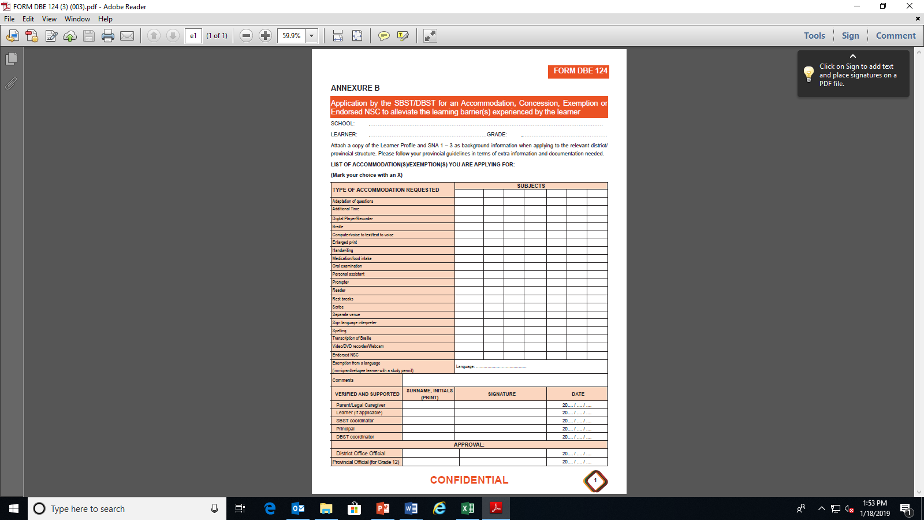
CHALLENGES…

Slide 49
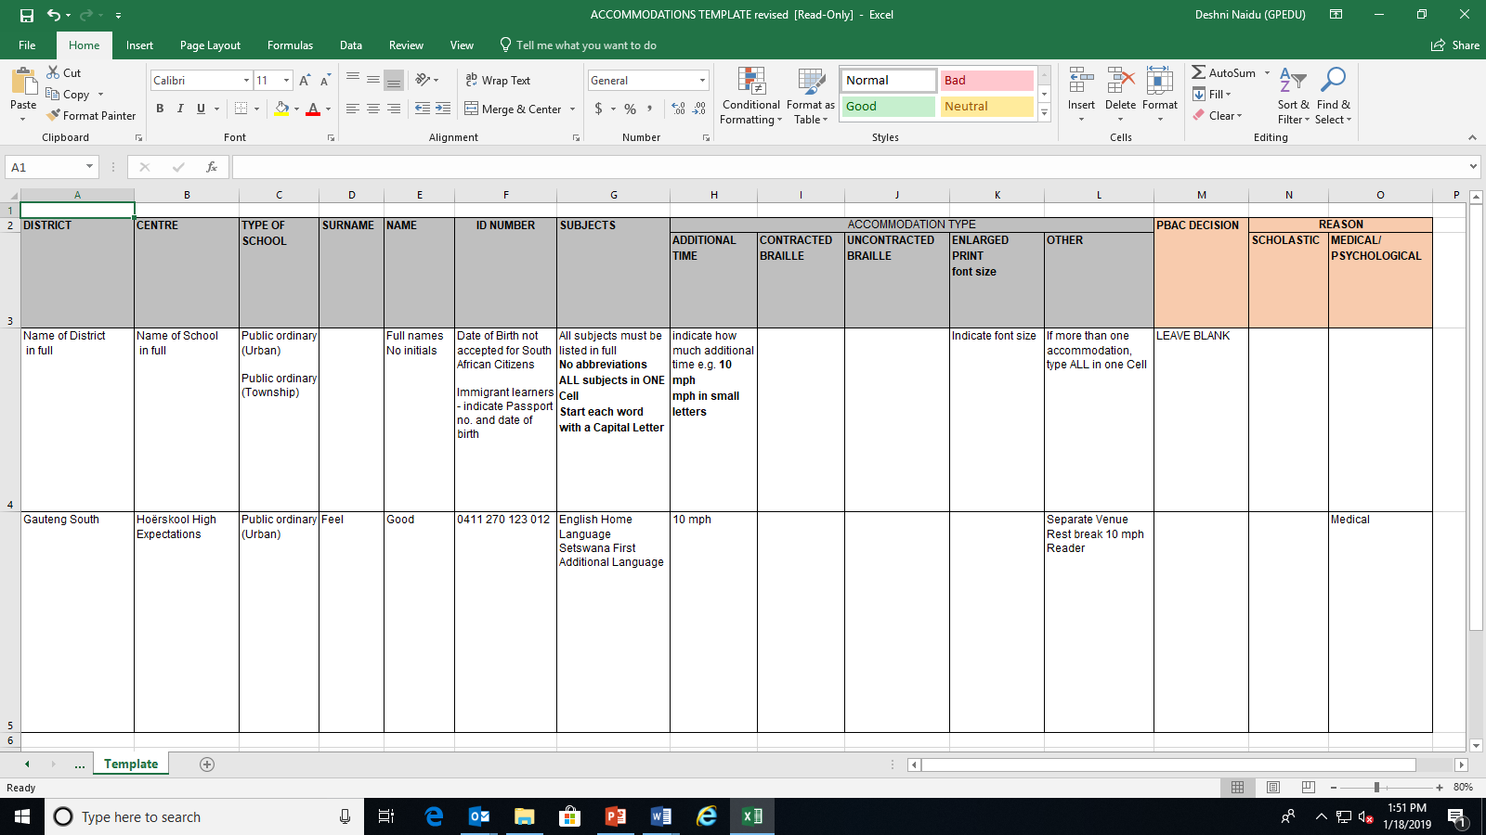

Slide 50
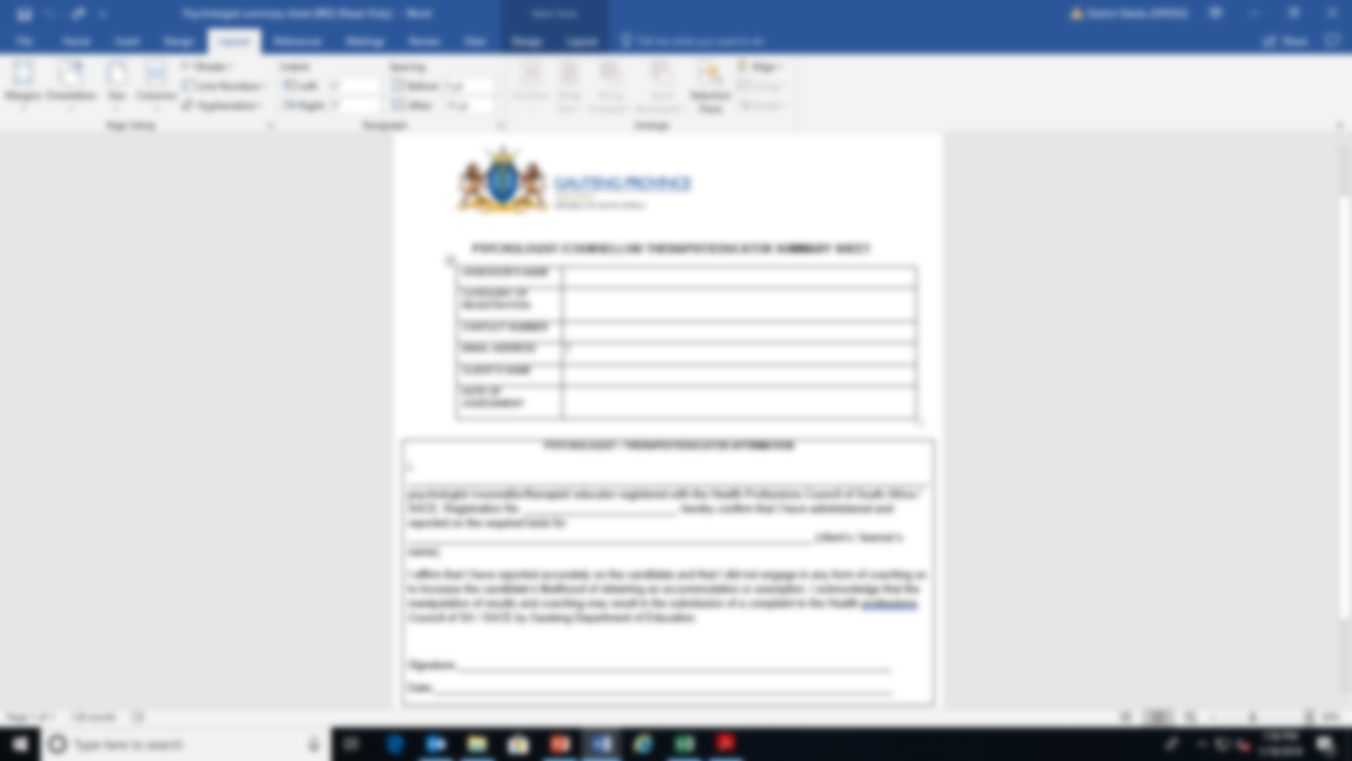

Slide 51
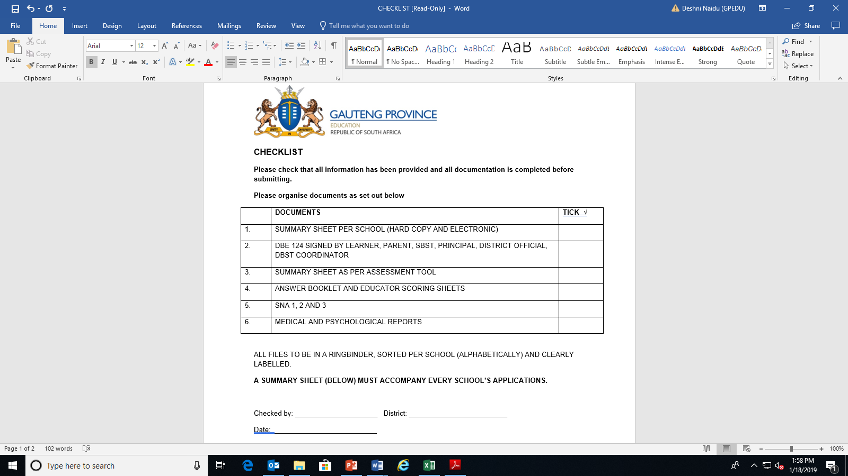

Slide 52
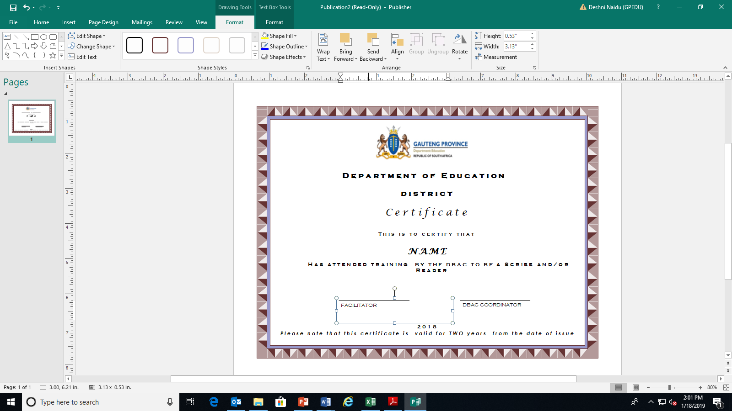

Slide 53
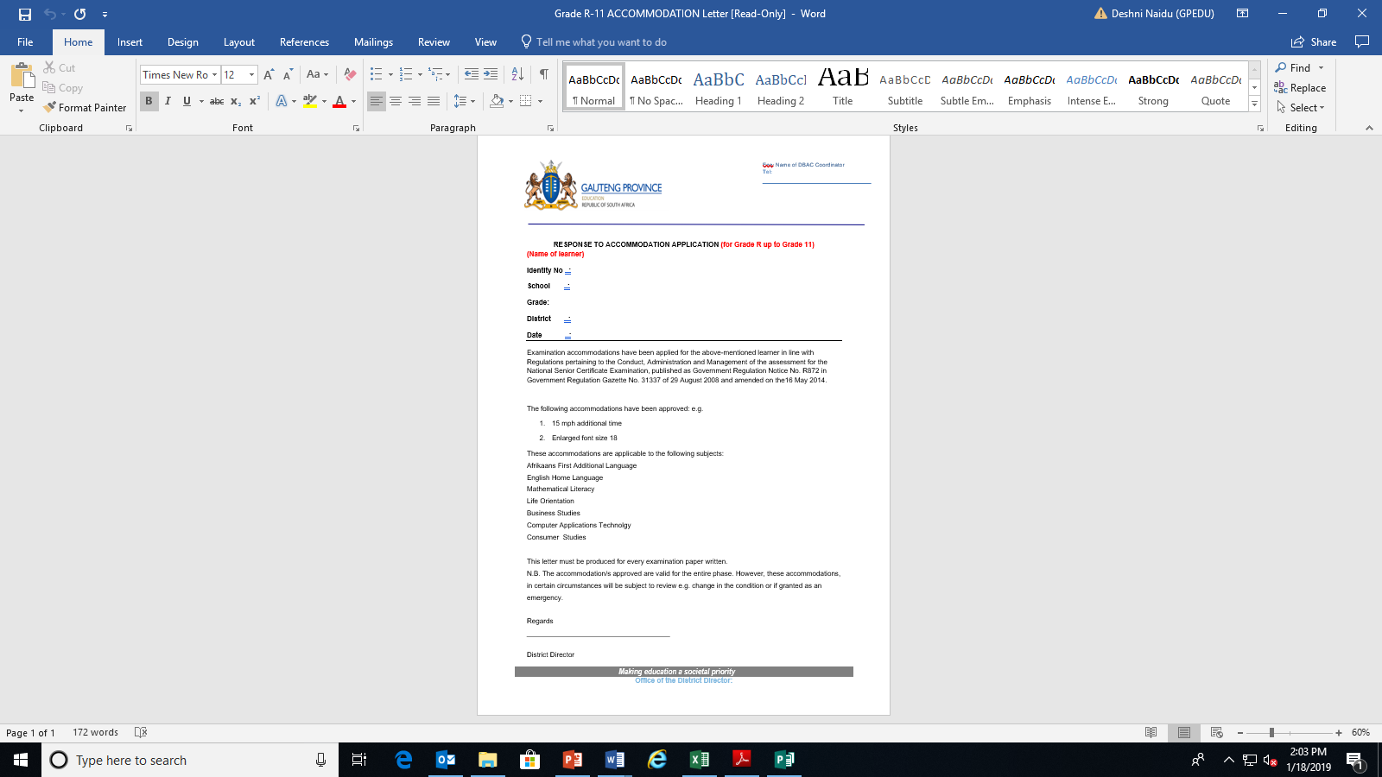

Slide 54
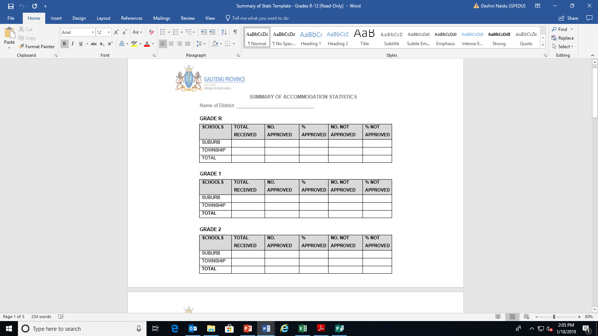

Slide 55
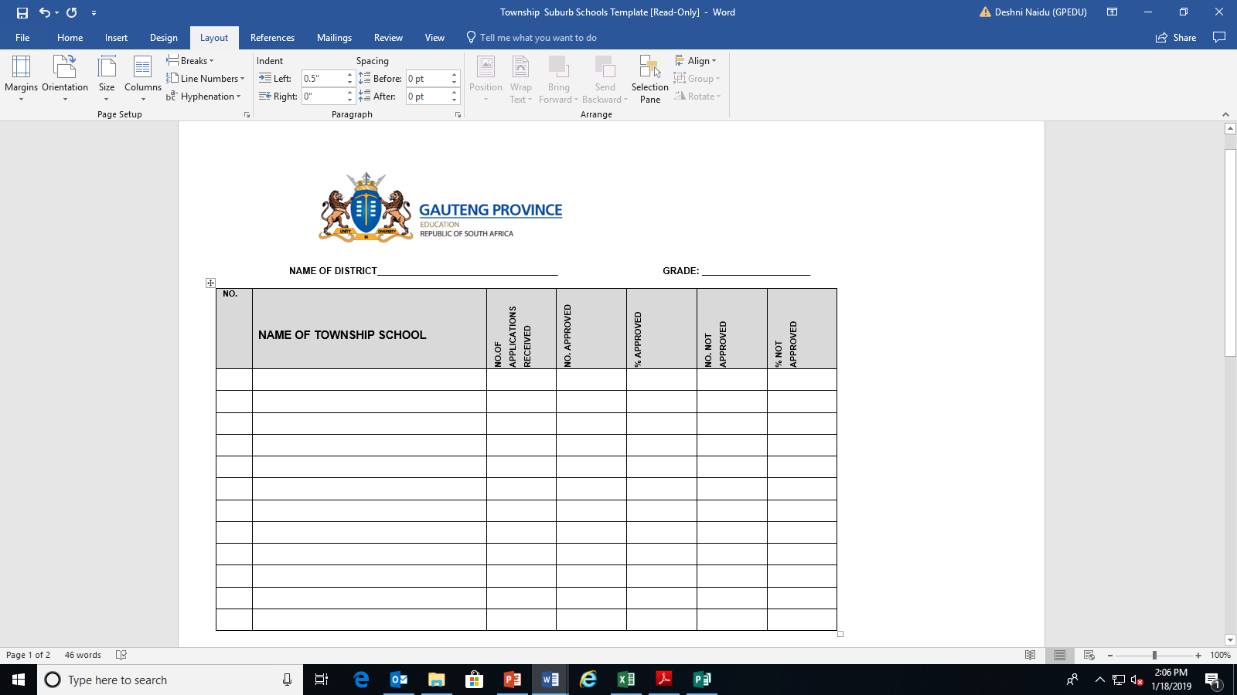

Slide 56
CHALLENGES
Schools are not trained on accommodations
All Public Ordinary Schools must be included in the accommodations training & training of readers & scribes
Training must be as per dates on management plan
early in the year
DBAC Coordinator must coordinate the accommodations for ALL circuits

Slide 57
CHALLENGES
Applications are not QUALITY ASSURED
Every application must be verified by the DBAC coordinator in conjunction with PBAC representative
from the District
The application must be signed by the DBAC Coordinator to indicate that the application was quality assured

Slide 58
CHALLENGES -VERIFICATION / QUALITY ASSURANCE
DBE 124
The DBAC coordinator must ensure the following:
DBE 124 form must be ONE page ONLY – request school to comply or resubmit with correct form
The application must be signed by the official who checked the application
The same official CANNOT sign for both positions.
DBE 124 must be signed PRIOR to submitting to DBAC and PBAC

Slide 59
CHALLENGES…
Ensure that accommodations applied for are appropriate
Learners completing DBE 124 themselves
requesting for accommodations such as:
Adaptation of Questions
Text to voice / voice to text
Video/ Webcam/ DVD recorder

Slide 60
CHALLENGES…
District Officials signing forms during the PBAC verification process - Accountability – signing on behalf of peers, professionalism
Return incomplete and unsigned forms to the school for completion
PBAC returns unsigned documents to DBAC

Slide 61
CHALLENGES…
SCREENING TOOL
Incorrect screening tool is used – old versions
The screening tool is incomplete, calculations and scoring incorrect – will be returned to DBAC
Date of assessment, date of birth and correct chronological age are not indicated – same age for ALL
Names do not correlate with all supporting documents
Educators writing responses
Comprehension questions answered on educator’s copy with answers

Slide 62
CHALLENGES
SCREENING TOOL
Sections incomplete
The summary sheet is not included
Administered in English (whilst LOLT is Afrikaans) to reflect poor performance to obtain accommodations
Private practitioners cannot use the GDE tool

Slide 63
Challenges continued…
SUPPORTING EVIDENCE
Samples of learner’s work to support accommodation application must be:
Recent - Current year
In LOLT – verify with school report
No Multiple Choice responses
Preferably a sample under test/exam conditions and class work
No draft copies of essays/mind maps

Slide 64
Challenges continued…..
SUPPORTING EVIDENCE
Samples of learner’s work not clear – scanned & copied repeatedly

Slide 65
Challenges cont…
OTHER CHALLENGES
Learner with previous accommodations, letter of approval to be attached
Accommodations granted to learners by the IEB (Independent Schools) do NOT automatically qualify/continue with those accommodations. A new application for GDE is required

Slide 66
CHALLENGES…
Schools granting accommodations without the approval of the District, letter from school to continue with the “accommodation”
Psycho-educational reports not in English
District Officials recommending that Mathematics should not be considered for promotion purposes (especially in Grade 9).
At the end of GRADE 9, accommodations to be reviewed - change of subjects

Slide 67
CHALLENGES Cont…
Grade 8 learners entering High School- review the need for Accommodations. School to be informed of the approved accommodations
Reader & Scribe applications are verified by PBAC

Slide 68
CHALLENGES Cont…
Accommodations Assessment Report ???
Accommodations granted by District Officials for 1 term only
Exemption from Mathematics in Grade 12 (Dyscalculia)
“Slow reader” – does not automatically qualify for a reader – consider EXTRA TIME.
Requesting a reader / scribe in Grade 12 when it was not approved by PBAC in Grades 10 & 11

Slide 69
CHALLENGES Cont…
Educator indicates that the learner has no challenges / should change subjects – address with school
Accommodations granted by District Officials for 1 term only
Exemption from Mathematics in Grade 12 (Dyscalculia)
“Slow reader” – does not automatically qualify for a reader – consider EXTRA TIME.
Requesting a reader / scribe in Grade 12 when it was not approved by PBAC in Grades 10 & 11

Slide 70
CHALLENGES…
PERIOD OF VALIDITY OF REPORTS
Medical Reports confirming a medical condition such as
blind/deaf/autism/epilepsy and CP – valid from first diagnosis
(from birth) – DO NOT need recent reports
Psycho-educational reports –valid for 2 years – lenient

Slide 71
CHALLENGES…
OTHER CHALLENGES WITH REPORTS
If Rooi Appel assessments are conducted-reports must be accompanied with a Psycho-educational assessment confirming a SLD diagnosis from DSM 5 confirming impairment in reading or written expression
Sick notes inadequate to grant accommodations
Letter from GP requesting “amanuensis” is insufficient

Slide 72
CHALLENGES…
The following documents DO NOT confirm a diagnosis:
Conners Comprehensive Behavior Rating Scales (Conners CBRS) multiple-choice questions that help screen for emotional, behavioral, and academic disorders
Copeland Symptom Checklist for Attention Deficit Disorders - Child and Adolescent Version
This checklist is designed determine whether a child or
adolescent has symptoms characteristic of ADHD

Slide 73
CHALLENGES…
The Vanderbilt Assessment Scale
This rating scale is used by professionals to screen for ADHD, oppositional defiant disorder, conduct disorder, anxiety and depression in children
Beck Youth Inventories
5 separate inventories to assess for depression, anxiety, anger, disruptive behaviour, and self-concept. Takes 5 minutes to administer each one
Results aid in the screening, planning, and monitoring
of children for educational placement and clinical treatment.

Slide 74
CHALLENGES…
Using 1 Minute Reading Test to grant a reader – only sight words – unacceptable
1 Min Mathematics to confirm dyscalculia – insufficient & inappropriate
ENGAGE WITH PROFESSIONALS
Report is too brief – not providing adequate information
Therapist report stating the learner has CP – disadvantage to learner
“Below Average” – in Cognitive Assessments -must be specific – call psychologist to get scores.

Slide 75
CHALLENGES…
Read professional reports and do not accept any report at face value
- SID learner diagnosed with dyslexia???
DO NOT APPROVE GRADE 10, 11 & 12 ACCOMMODATIONS
APPROVAL IS DONE BY THE PBAC

Slide 76
QUESTIONS AND ANSWERS
THANK YOU FOR ATTENDING
DRIVE SAFELY
THANK YOU FOR YOUR ATTENDANCE

